Slide 1

P-201- GROUP-5
PRESENTING
RESUME CLASSIFICATION
MENTOR – SAURABH SINGH

Slide 2

TEAM MEMBERS
Hanumandas T.
Shital Auti
Karnti Vaishnav
Pooja Midage
Mandara T.
Thanuja
Shunottara Alhat

Slide 3

Business Objective
A resume is one of the documents employers may request you to submit as part of an application package. Resumes allow applicants the opportunity to describe their experience and skills in their own words. It’s helpful to review information about resumes and learn what to include in a resume to make yours as effective as possible.
A formal document that provides an overview of your professional qualifications, including your relevant work experience, skills, education, and notable accomplishments.

Slide 4
WHAT IS RESUME CLASSIFICATION
On a base level, a resume is made up of the following five parts:
Contact details
Introduction
Educational background
Work history
Relevant skills

Slide 5
TYPES OF RESUME :-
There Are 5 Types of Resume
CHRONOLOGICAL RESUME.
FUNCTIONAL RESUME
COMBINATION RESUME
MINI RESUME
NON-TRADITIONAL RESUME

Slide 6

Project Architecture / Project Flow
Model deployment
Understanding business problem
Collection of data
Cleaning of data
Exploratory data analysis
Model building

Slide 7

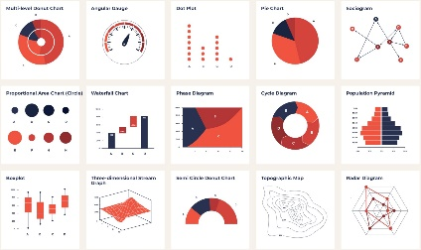



Work Flow Of Our Project
Objective of Business
Data Preprocessing
E.D.A
Data Collection
Model Building/ Evaluation
Model Deployment

Slide 8






Tools which are Used :

Slide 9



Exploratory Data Analysis (EDA)

Slide 10
DATASET DETAILS
Number of .doc files = 26 Number of .pdf files = 1 Number of .docx files = 52
Total resume = 79

Slide 11
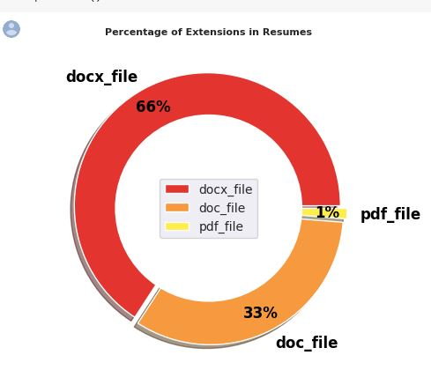
DATA
Here is data of Resume in Percentage.

Slide 12
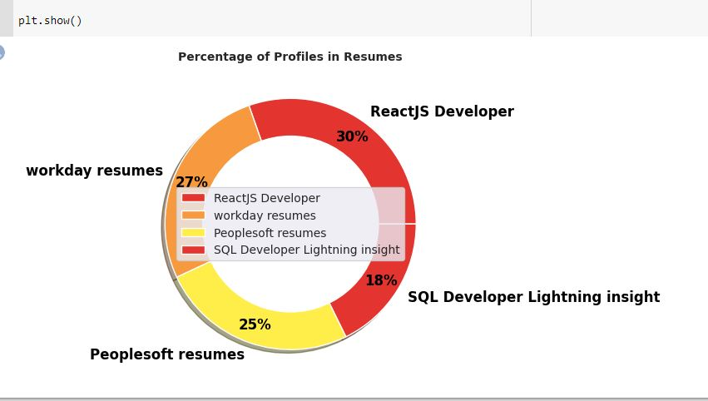
Information on Data
ReactJS Developer 30%
workday resumes 27%
Peoplesoft resumes 25%
SQL Developer Lightning insight 18%

Slide 13



MODEL BUILDING

Slide 14
Model Building method which were used are
SVM (Support Vector Machine)
RANDOM FOREST CLASSIFIER
NAIVE-BAYES CLASSIFIER
DECISION TREE CLASSIFIER
ADABOOST CLASSIFIER
GRADIENT BOOSTING CLASSIFIER
XGBOOST CLASSIFIER
LGBM-BOOSTING CLASSIFIER
MULTINOMIAL LOGISTIC REGRESSION MODEL

Slide 15

Model Evaluation
METHOD | ACCURACY
SVM (Support Vector Machine) | 0.875%
RANDOM FOREST CLASSIFIER | 100.0%
NAIVE-BAYES CLASSIFIER | 0.8125%
DECISION TREE CLASSIFIER | 100.0%
ADABOOST CLASSIFIER | 0.75%
GRADIENT BOOSTING CLASSIFIER | 100.0%
XGBOOST CLASSIFIER | 100.0%
LGBM-BOOSTING CLASSIFIER | 100.0%
MULTINOMIAL LOGISTIC REGRESSION MODEL | 100.0%

Slide 16
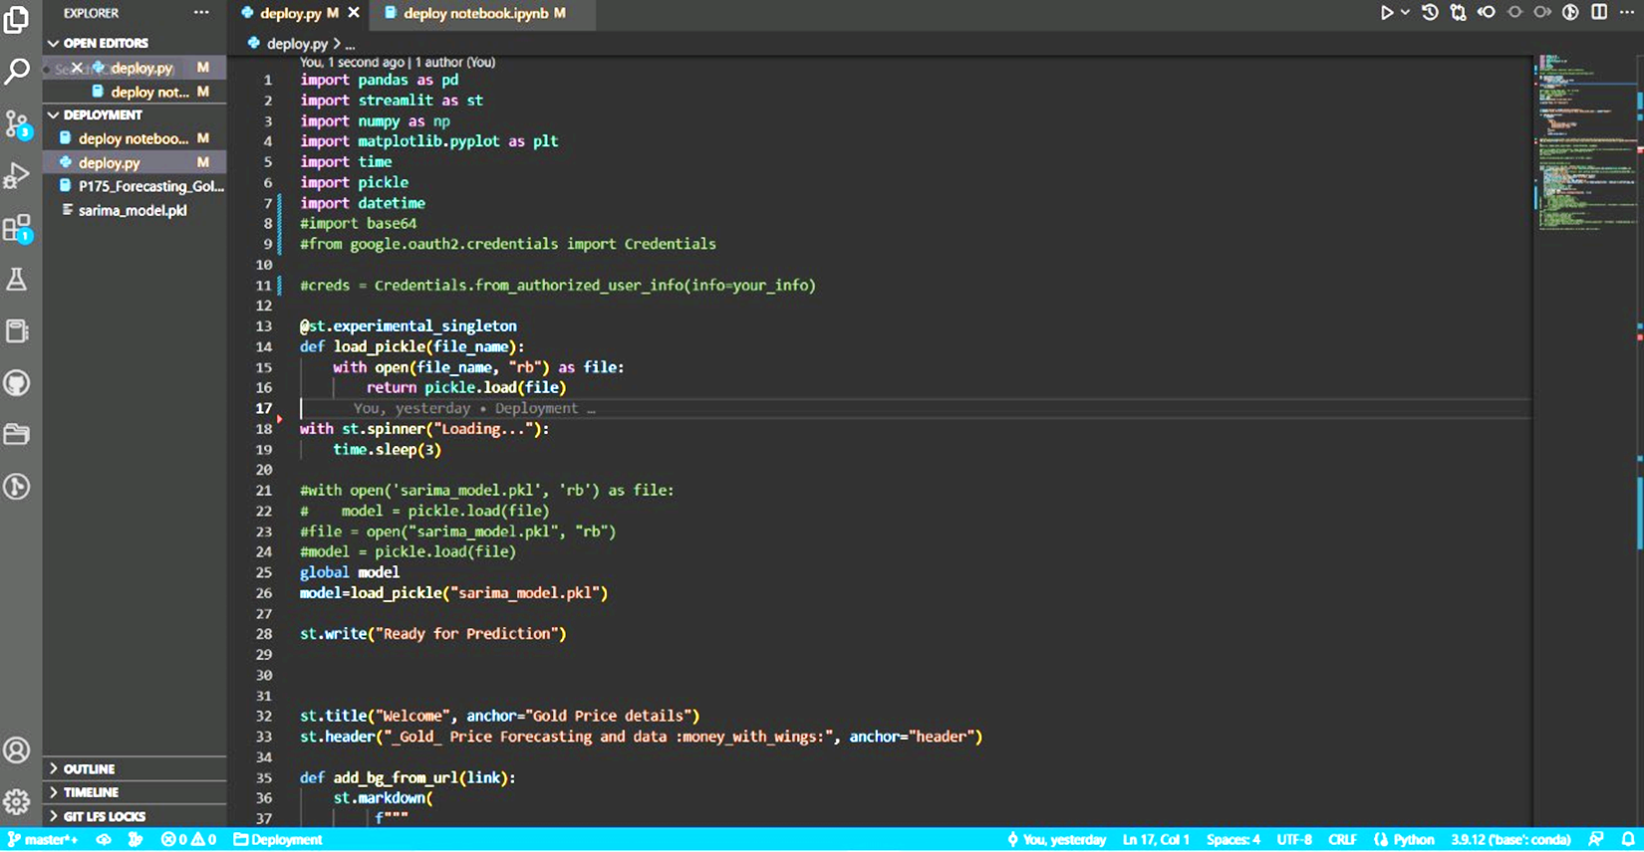
Model Deployment

Slide 17


